Slide 1
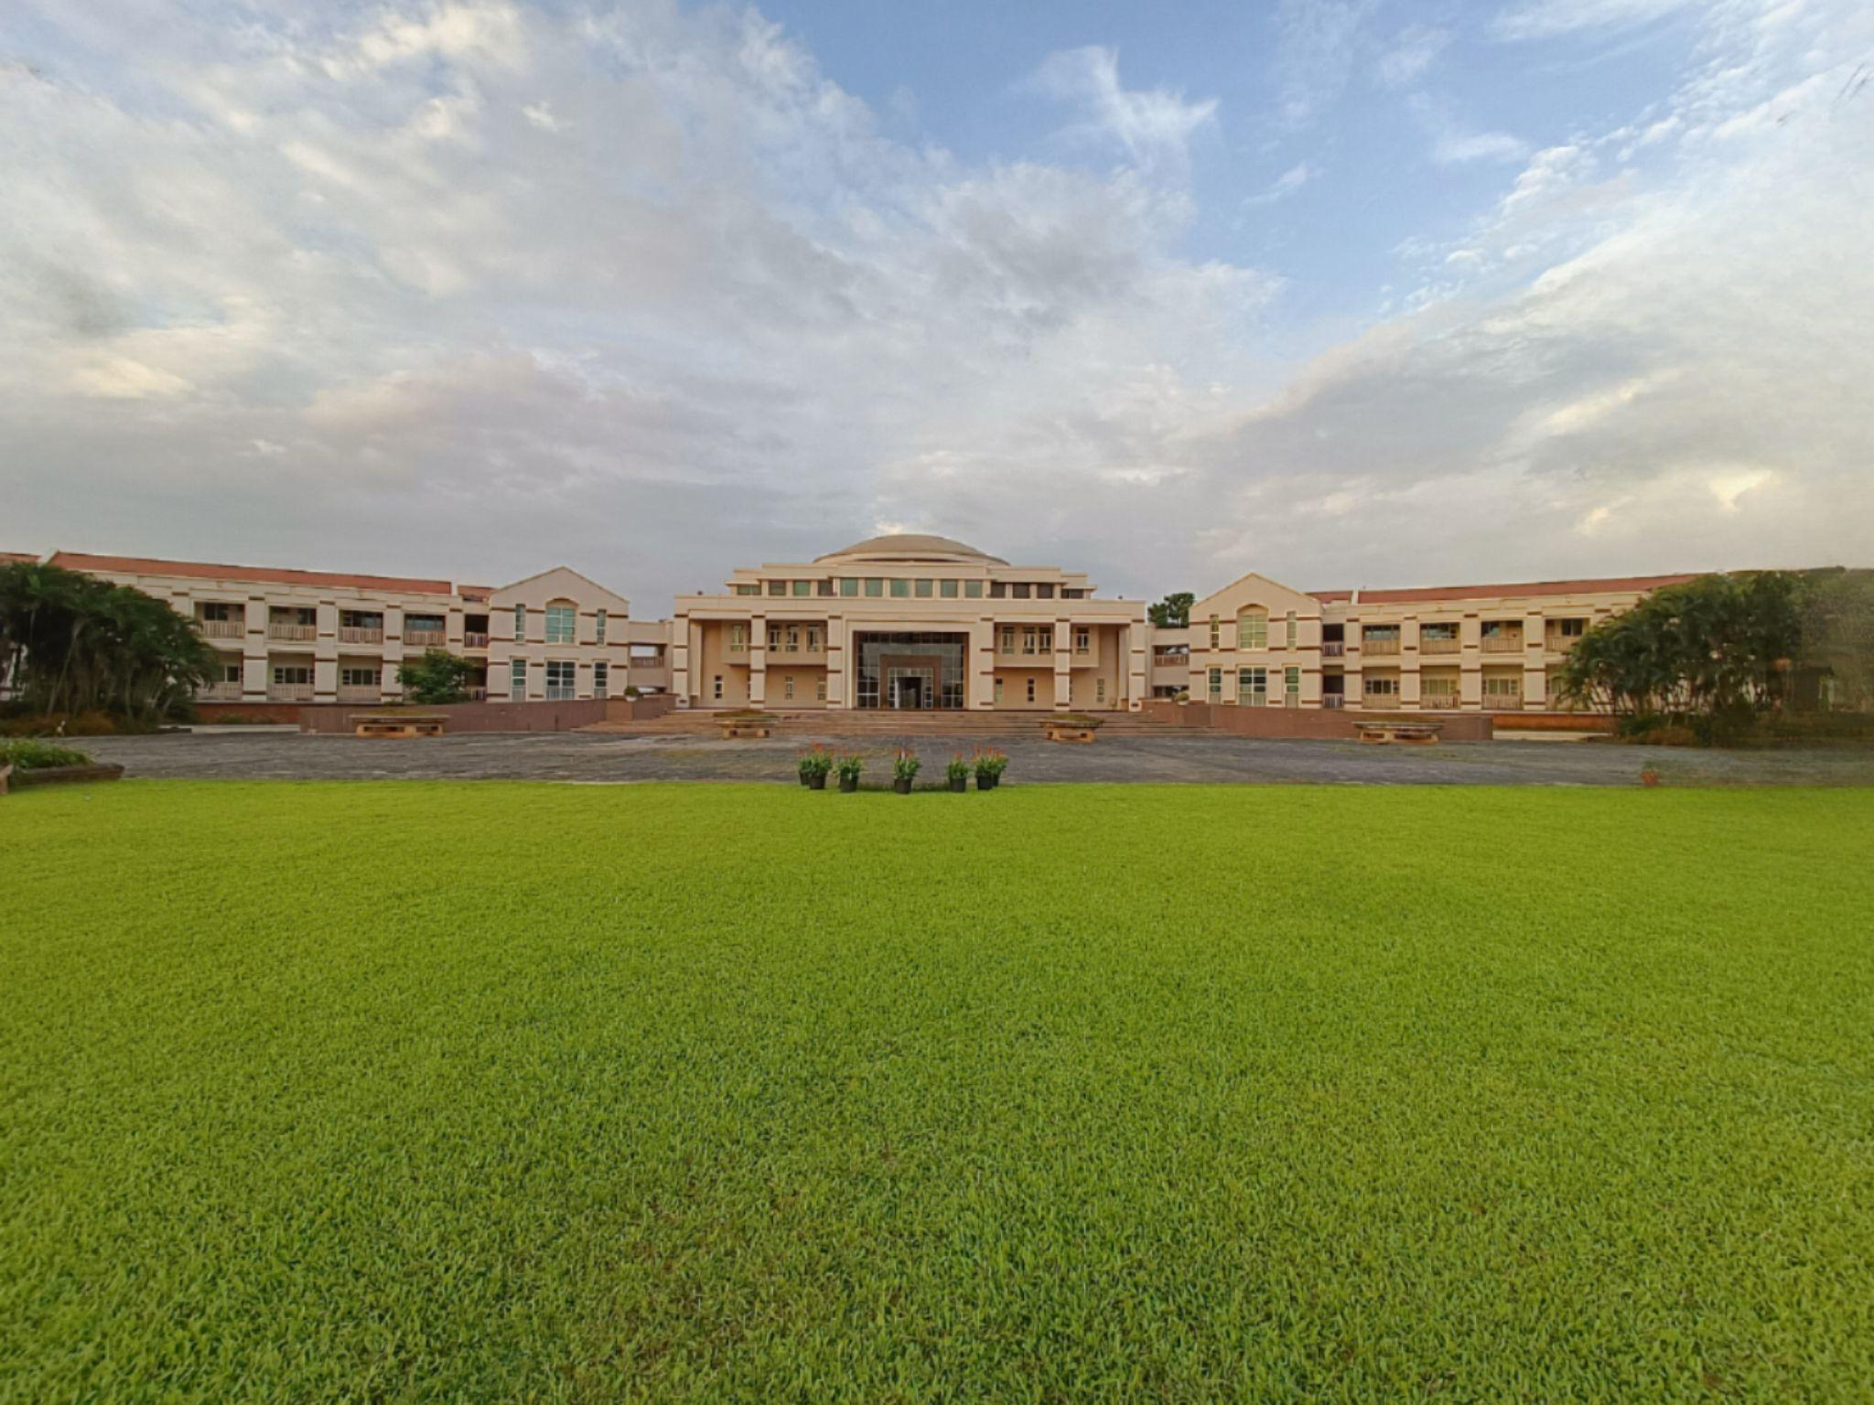

BITS Pilani
K K Birla Goa Campus
Opportunities and Challenges in Real-world System Deployments
Keshav Kaushik and Vinayak Naik
BITS Pilani Goa, INDIA

Slide 2
Introduction
Solving real-world problems using computational techniques gained significant research interest
To solve such problems we need to deploy systems in real-world
These deployments are made possible due to the advancements in the Internet of Things (IoT)
An IoT deployment consists of various sensors and actuators connected to the things present in real-world

Slide 3
Challenges
Communication Sensors present in the environment needs to transmit information
Data Collection We need to collect such that it satisfies following characteristics — Volume, Velocity Value, Variety, and Veracity
Computation We need to process the collected data to generate useful information for desired outcome
We propose to optimize cooling systems’ energy consumption in the real-world

Slide 4
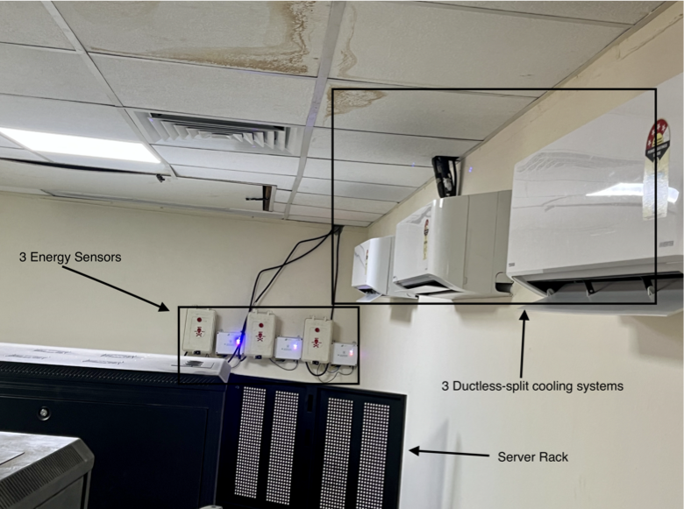
Our Deployment Scenario
Energy Sensors
Ductless-split Cooling Systems
Server Rack

Slide 5
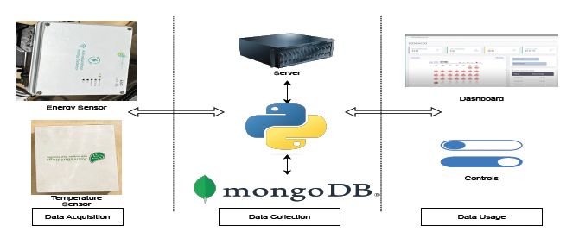
Architecture of Deployment

Slide 6
Challenges Faced
The Dataset is accessible at OEDI platform
Communication
In-consistency in the WiFi Network
WiFi modules gets damaged after a period of time
Solution– Upgraded to 5G communication
Data Collection Need of collecting new parameters
Solution– Using NoSQL database
State Inconsistency The ON/OFF state of actuator changes after each time the sensor restarts
Solution– To update the state of actuator at regular intervals using latest information present at server
We acknowledge the ACM SigMobile for providing us SigMobile Community Grant
I am available in job market, and looking for PostDoctoral and Industry positions. Please reach out to me if you have any openings
keshavkaushik.info

